Slide 1



Knewton Ed
Smart AI-Digital Based Solutions for Education Analysing
01
Team Coderaptors - Octahacks 3.0
Team Push that Code - Hackoff 3.0

Slide 2





Push that Code
Members
Harsh Shaw
Frontend Developer
Harsh Sharma
ML Developer
Preetam Sarkar
Backend Developer
02
Rishabh Abhani
AI and Backend Developer
Sulaksh Sharma
Frontend Developer

Slide 3

The Problem
03

Slide 4
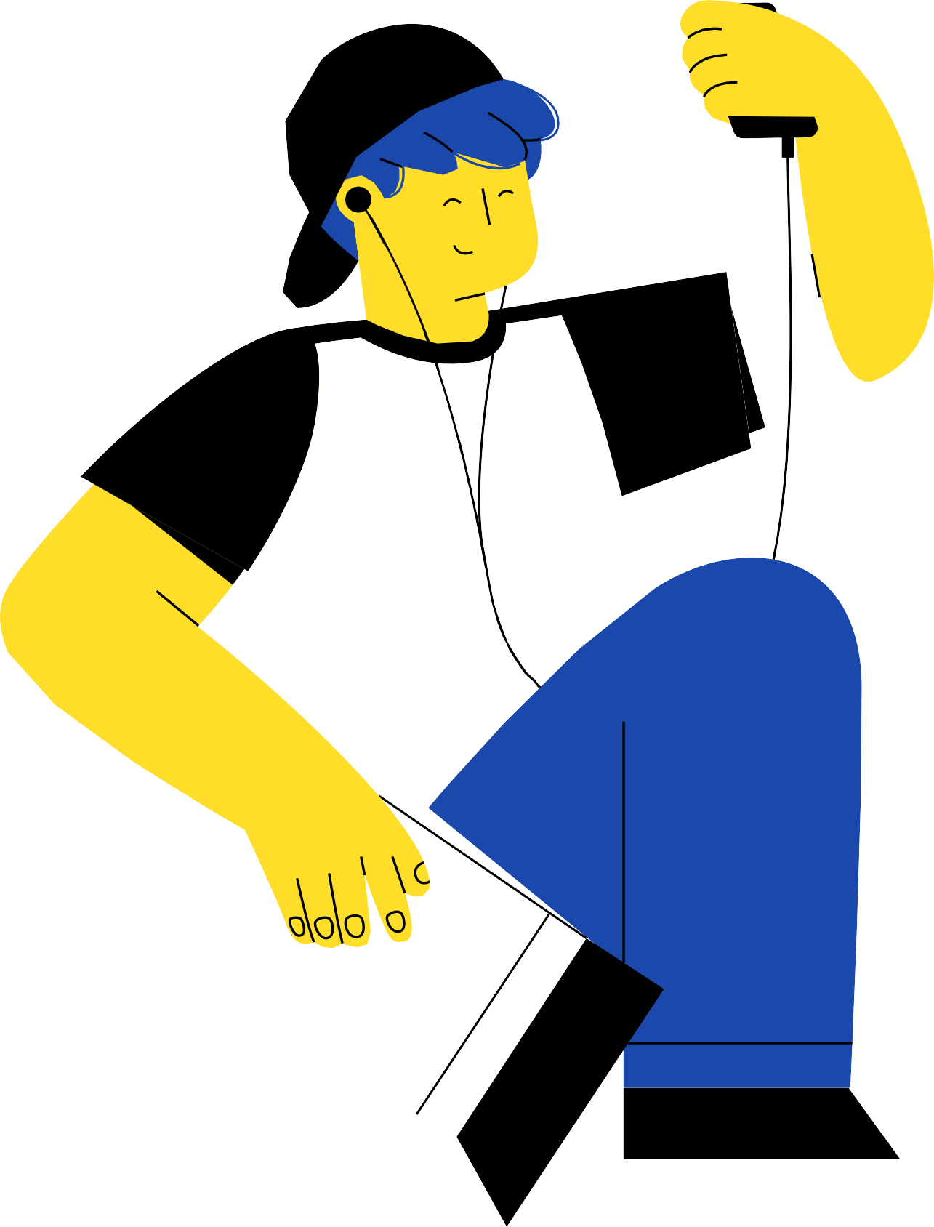
Background
Overview of the project
The impact of pandemic COVID-19 is observed in every sector around the world. The education sectors of India as well as world are badly affected by this. It has enforced the world wide lock down creating very bad effect on the students’ life.
04
Around 32 crore learners stopped to move schools/colleges and all educational activities halted in India. The outbreak of COVID-19 has taught us that change is inevitable. It has worked as a catalyst for the educational institutions to grow and opt for platforms with technologies, which have not been used before. The education sector has been fighting to survive the crises with a different approach and digitising the challenges to wash away the threat of the pandemic..

Slide 5

The Problem
05
What we want to solve
The COVID-19 pandemic has had a number of consequences in different Sectors, one of which was the Education Sector.
Hypothesis
We have tried to develop a smart AI Based digital Platform Using Machine Learning /AI and Web based skills to make a secure web application , which aims to analyze the user's information,it can be a Faculty or Student. Using Appropriate Tech Stack , this app tries to analyse and resolve.

Slide 6
Objectives
What we want to achieve
To have a platform where student can upload their assignments.
To check plagiarism of the assignments sent by the students, the teacher can check if any student had copied the assignments or not.
06
To give a short summary and finding the main key points in the assignment so that it could save time for the teacher.

Slide 7

The Models
Working
08

Slide 8


Overview of ML / AI Models
1. Pdf Optical Character Recognition based text Extraction [OCR]- Using Pytesseract and Opencv and Pdf-plumber libray, Text Can be extracted by the pdf documents.
2. Summarizer and keyword extraction- Analyses Pdf 's Text and returns summary and main points and keywords of student's answer sheet.
3. Plagirism Detection - Using Natural Language Processing Techniques and cosine similarity , our app can identify whether two students uploaded documents content have been plagirised or not .
4. Auto Evaluate - Using Narural Language Processing Techiniques , this app can automatically evaluate a student's answer sheet and can evaluate it against original answer ky provided by faculty and can calculate marks easily.
5. Student Dropout- Using Machine Learning , our app can easily predict whether a particualr student is on verge of getting arrears or dropouts.This can help him to connect with suitable faculties who mught help them to prepare for the fortcoming exams accordingly.This way , Faculty can help them remotely address their concerns and doubts
6. Student Counsel- Using Machine Learning , our app can easily help a student identify which type of a job role would be suitable for him , based on inputs as in skills and experience received by user.This way , Faculty can help them remotely address their concerns and doubts reagrding their future aspects and can help them to train and prepare in suitable manner.
7.Fully Secured Using Login Authetication
09

Slide 9



This App Can Be used for all sorts of Education Platforms
1 1

Slide 10

Thank You!
:)
1 3

